Slide 1
Generating Insights from Clustering Large Donors
Brad Stieber Data Analyst, Wisconsin Foundation and Alumni Association Brad.Stieber@supportuw.org | bgstieber.github.io

Slide 2
Overview
Background and Context
What is Unsupervised Learning
Three Clustering Algorithms You Should Know
Using Results from Unsupervised Learning
An Example from WFAA
Bonus: Large Donor Disruption in Philanthropy
Wrapping Up
Notes:
First, provide some information about my background, then lay the foundation for talking about UL, and finally discuss
How we’ve used it at WFAA to cluster our large donors, and why that group is so important

Slide 3
About Me
Data Scientist with experience in non-profit and private finance
Passionate about communicating quantitative information effectively
Main tools are R, SQL, and Tableau
Frequently quote Box, Tukey, and Wickham
All models are wrong, but some are useful.
George Box
The best thing about being a statistician is that you get to play in everyone’s backyard.
John Tukey
Tidy datasets are all alike, but every messy dataset is messy in its own way.
Hadley Wickham

Slide 4
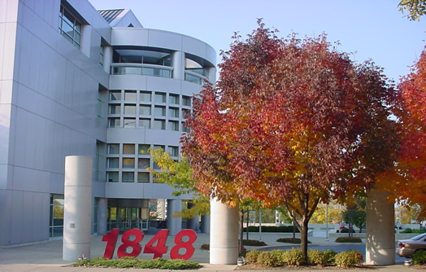

About WFAA
Official fundraising and gift-receiving organization for the UW–Madison
In the midst of a $3.2B campaign, ending in 2020
Staff of 300, 70 development officers, 13 in Data Solutions Team (DW, BI, DA), 13 in Research

Slide 5
Unsupervised Learning

Slide 6
Using UL: Right and Wrong Times

Slide 7
Three Clustering Algorithms You Should Know
K-Means
Hierarchical Clustering
DBSCAN
Bonus: Dimensionality Reduction
Notes:
DBSCAN-Density-based spatial clustering of applications with noise

Slide 8
K-Means
“Hello, world” of clustering algorithms
Simple, yet effective
Need to specify number of clusters, many methods for determining optimal number of clusters, but depends on context

Slide 9
Hierarchical Clustering

Slide 10
DBSCAN
More advanced than K-Means or hierarchical clustering
Useful in outlier detection and is flexible with respect to cluster shape
DBSCAN is “region-based”, trying to identify neighborhoods of densely packed data points
Don’t specify number of clusters, but need to specify epsilon (radius) and minimum points (number of neighbors to be a core point)
Notes:
DBSCAN-Density-based spatial clustering of applications with noise

Slide 11
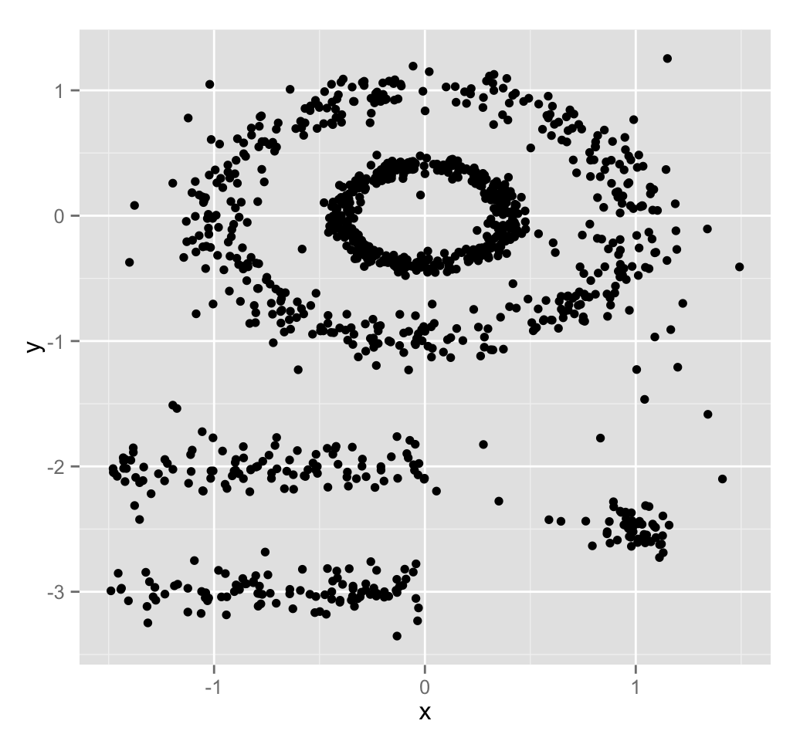
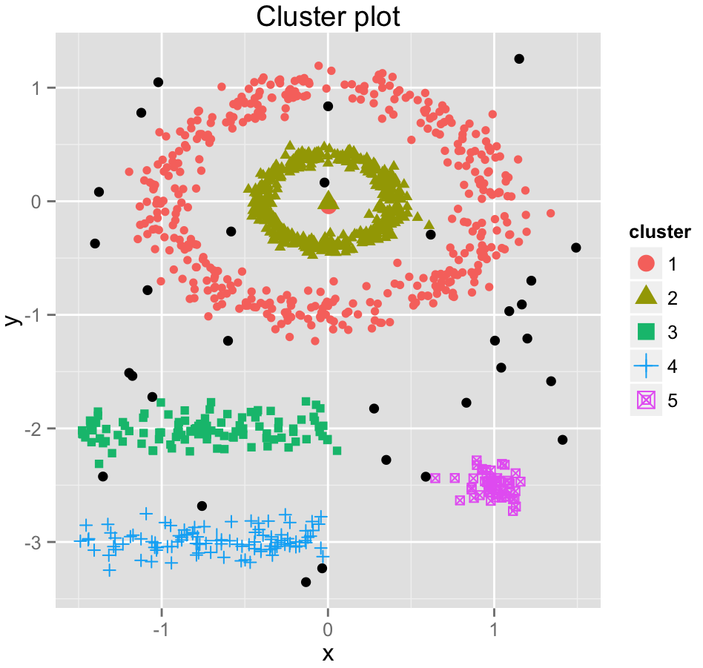
DBSCAN Example
http://www.sthda.com/english/wiki/wiki.php?id_contents=7940

Slide 12
Bonus: Dimensionality Reduction

Slide 13
Example from WFAA – Setup

Slide 14
Example from WFAA – Data/Methods

Slide 15
Example from WFAA – Results

Slide 16
Example from WFAA – Implementation

Slide 17
Large Donor Disruption

Slide 18
Large Donor Disruption

Slide 19
Large Donor Disruption

Slide 20
Wrapping Up

Slide 21
Wrapping Up

Slide 22
Wrapping Up

Slide 23
Questions?
Brad Stieber Data Analyst, Wisconsin Foundation and Alumni Association Brad.Stieber@supportuw.org | bgstieber.github.io

Slide 24
Thank You!
Please complete your session evaluations in the mobile app.

